Slide 1






PLANETARY CHEMISTRY: THE QUEST FOR IRON OXIDE
Teacher Guide
An exoplanet mission to get iron (III) oxide:
A virtual AI-lab: choice of sampling site and initial characterization of the sample.
A hands-on chemistry lab: sample colorimetry, precipitation, filtration and thermal decomposition.
TAI Erasmus+ Project · Field-tested July 2026

Slide 2
The Mission
The Aurora Network is a system of scientific stations spread across several exoplanets that monitor climate, geology, and possible signs of life. After a powerful radiation storm damaged one station, engineers need to manufacture new iron-oxide-rich ceramic bricks to restore the protective shielding around sensitive instruments. Because transporting construction materials from Earth is slow and costly, scientists are searching for a local source of iron on nearby planets. Your mission is to use a rover and its AI laboratory to identify the planet most likely to contain iron-rich minerals and determine which sample could produce the greatest amount of iron oxide Fe₂O₃. The results of your laboratory analysis will help decide whether the deposit can provide enough material to repair the station's shielding.
Lesson steps (total 90 min):
(20-30’) Virtual AI lab: choice of site at the exoplanet to sample from. Initial characterization of the sampled iron compound.
(60-70’) High school chemistry lab — sample arrives at Earth’s lab: estimation of sample concentration, chemical reactions to extract and weigh iron oxide.
TAI Erasmus+ Project · Chemistry lesson Teacher Guide
2

Slide 3
AI virtual Lab
How to use the AI virtual Lab app as a teacher for this lesson:
Open the app — https://scientificailab.streamlit.app/RoverLab
Click on the “Rover Lab” tab — and switch to the "Teacher" mode within it.
Share one link per group of students — In the “Teacher” mode, choose one of the built-in scenarios (there are 8 exoplanet dossiers, one per group of students. The “Vestara-3” scenario is just a demo example) or upload your own .docx dossier. The app generates a unique share link for that specific scenario. Each link opens a student-only view with no navigation and no way to see the answer — so a teacher running multiple groups just repeats this once per group, handing out a different link to each.
Further guide — at the bottom of the page for each selected scenario, you can find the data that is in the selected exoplanet dossier (“Full scenario details”) and a detailed Teacher guide on how to use the app.
Students’ interaction with the AI lab — Throughout the interaction, the AI never confirms the answer outright; it only reports test results and reasons about possibilities, so students have to work it out from the evidence themselves.
STUDENTS’ GOAL FOR AI-LAB PART:
Choose the correct site
  Site 1 is in all scenarios the one containing an iron compound. All others do not contain any iron in any form.
Get a hypothesis of the iron compound that is in the sample
  Fe(Cl)₃
The sample is sent to the Earth’s lab at the end of this part
TAI Erasmus+ Project · AI Lab Teacher Guide
3

Slide 4
AI virtual Lab
STUDENTS’ WORKFLOW WITH THE ROVER LAB:
Open the link their teacher shared — lands directly in the mission, no menus or setup needed.
Read the mission briefing — the radiation-shield/iron story and what they're trying to find.
Look at the landing-site overview photo and the list of candidate sampling sites.
Pick a site to send the rover to (costs energy) — see its close-up photo and description.
Choose a physical test to run there (pH, density, conductivity, magnet, etc.) — also costs energy, and returns just the measured result.
Ask the AI lab general questions anytime, for free — background chemistry/geology, or "what could these results mean?"
Repeat across sites, managing their limited energy budget, until they've gathered enough evidence.
Reason as a group to decide which site's sample should be sent to Earth — the AI never states the answer, so they have to argue it from the data themselves.
Make an hypothesis about what iron compound is the one in the sample sent to Earth
Throughout the workflow — fill in the pdf with questions and guidelines for the chemistry lesson.
TAI Erasmus+ Project · AI Lab Teacher Guide
4

Slide 5
Chemistry lab on Earth (high school lab)
Each group receives a water sample from their exoplanet. Dissolved in it is iron(III) chloride (FeCl₃).
Working like a science team, each group must find out how much iron(III) oxide (Fe₂O₃) they can extract from their own sample. Once every group has a result, the class compares all 8 candidate exoplanets and decides together which one is worth the trip.
Chemistry skills worked throughout the lesson:
Colorimetry — estimating concentration from colour
Precipitation — predicting and observing FeCl₃ + KOH reaction
Filtration* — isolating a solid product from solution
Thermal decomposition* — converting a hydroxide Fe(OH)₃ into an oxide Fe₂O₃
Stoichiometry — checking a measured yield against a prediction
*Processes that take waiting time (time where you just wait for it to happen).
WHY THIS SAMPLE?
8 exoplanets, 8 samples — but only some are genuine. Three are harmless decoys (water + food colouring). The rest contain real FeCl₃ at different concentrations.
The overall goal is to determine which exoplanet has the largest amount of iron oxide.
3 decoy samples (plain water + food colouring)
0.1 mol/L
0.2 mol/L
0.8 mol/L
1.6 mol/L
3.2 mol/L
TAI Erasmus+ Project · Chemistry Lab Teacher Guide
5

Slide 6
Materials & Safety at a Glance
MATERIALS
Solid FeCl₃ (iron(III) chloride) and KOH (potassium hydroxide) pellets
Distilled water (also possible with tap water – this is how it’s been tested)
A precision balance (minimum 0.1 g resolution)
Beakers, test tubes and a test-tube rack
Filter paper and a funnel (the bigger, the better)
A hot plate or pan able to reach ≥200°C
Gloves, lab coat and safety goggles for every student
Food colouring (orangish), for the 3 decoy “exoplanet” samples
SAFETY
KOH is caustic — gloves and goggles on for solid pellets and solutions alike.
High heat is involved — supervise the roasting step closely and let samples cool fully before weighing.
Treat every sample as real — even though 3 of the 8 are harmless decoys, keeping the same handling routine avoids mix-ups and keeps the mission framing intact.
Standard lab rules apply — no eating/drinking at benches, tie back hair, dispose of KCl filtrate and other final residues as directed by your school's waste policy.
TAI Erasmus+ Project · Chemistry Lab Teacher Guide
6

Slide 7
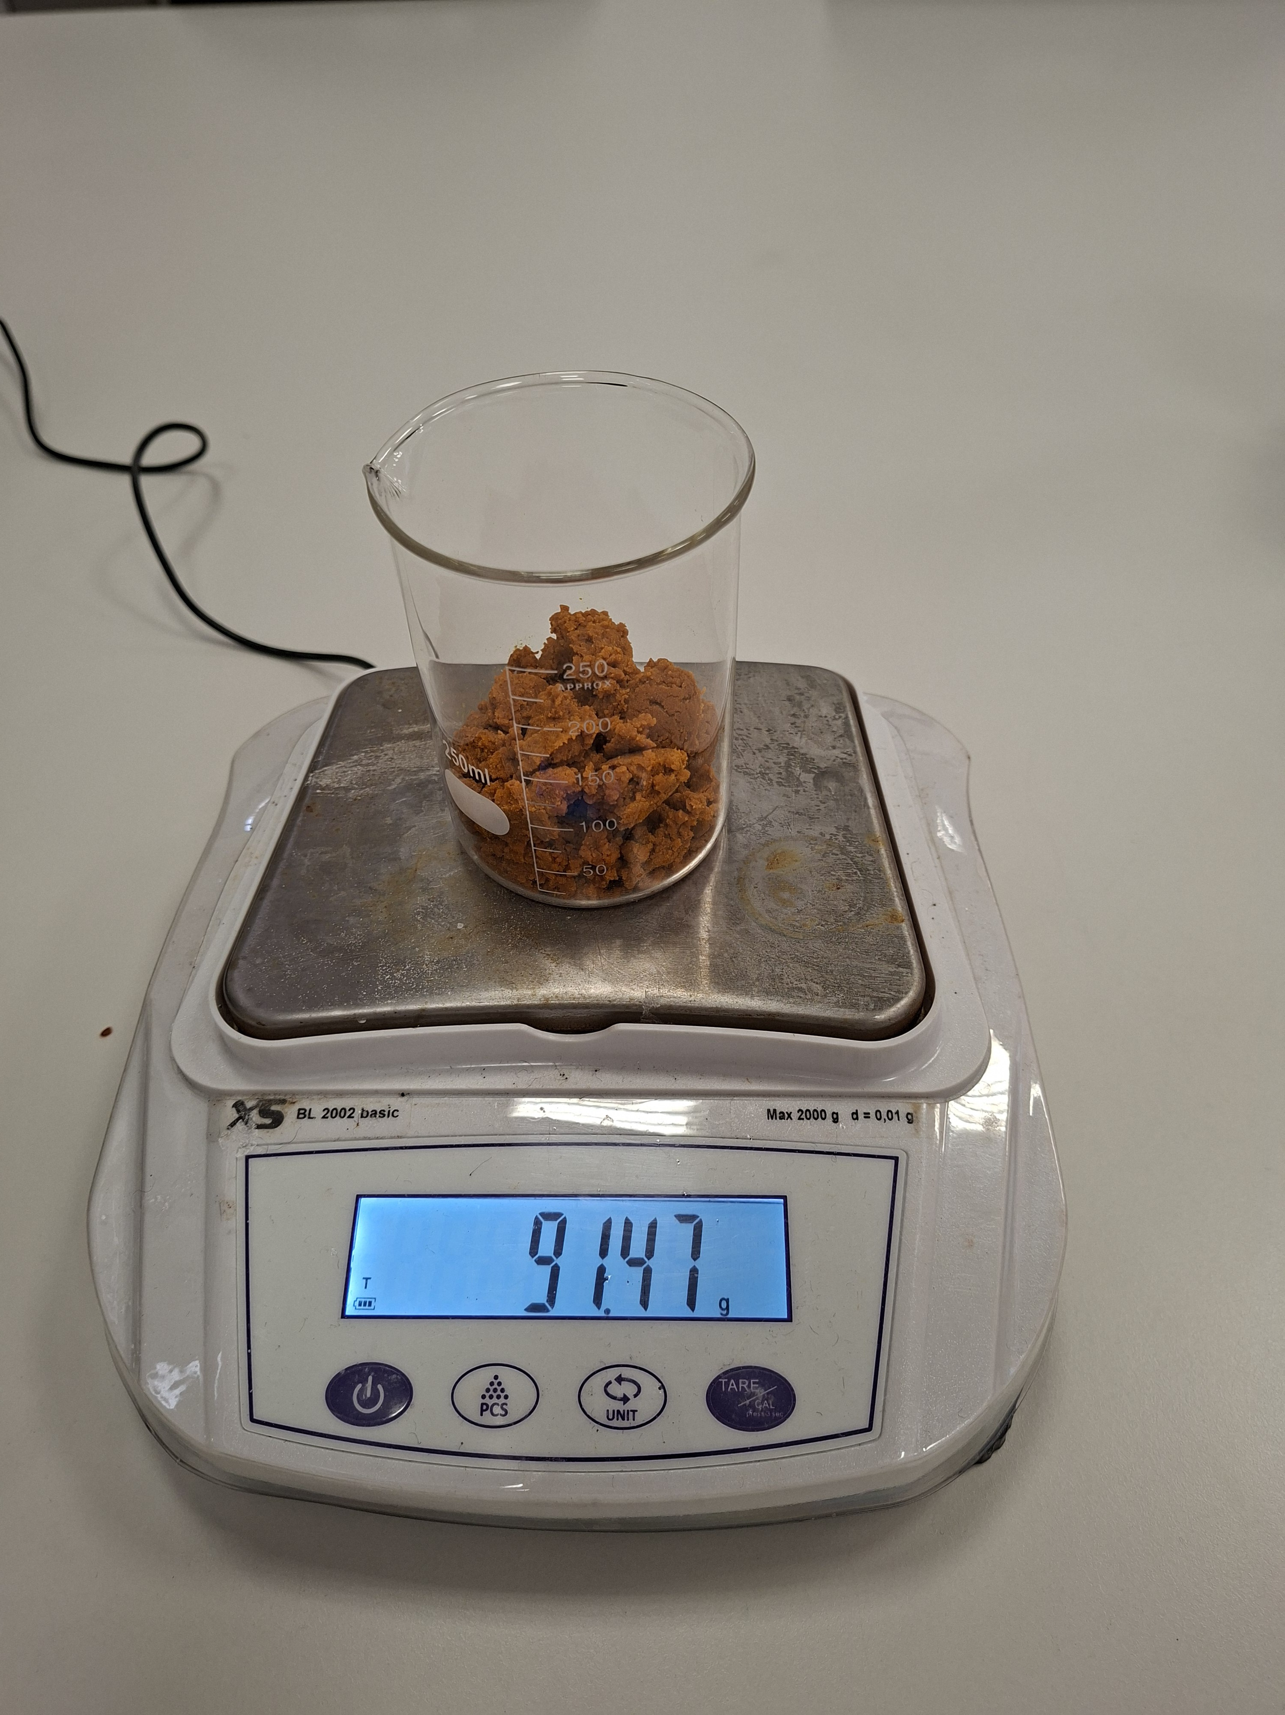
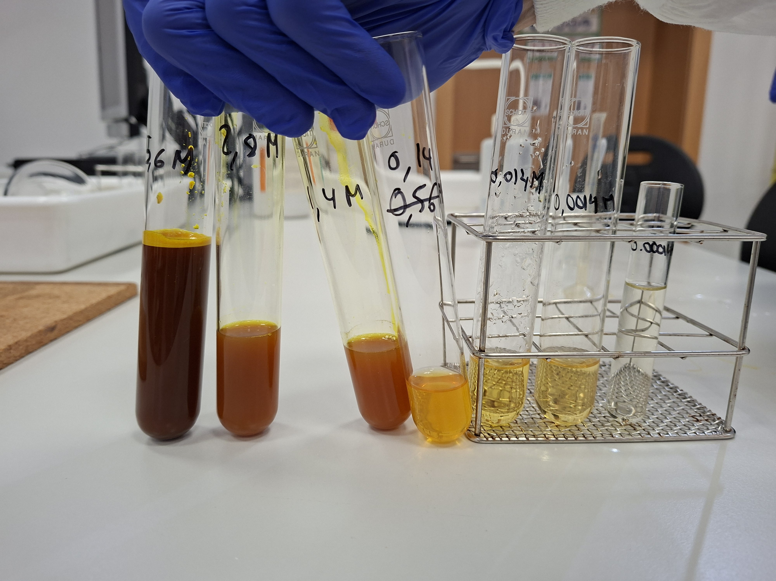
Before Class — Prepare samples & Build the Colour Reference Scale
Prepare 8 samples for the 8 groups of students, and 8 starting solutions of 4M (see box).
Colorimetry only works if students have something to compare their sample against. Even though students themselves can create their own control sample sequence, it is recommended that there is one fully correct one (before class starts). Doing the colorimetry themselves can be an additional step that the students can do in case there is more time than 90 min.
How to prepare the labelled reference scale:
1. Prepare a saturated stock solution of FeCl₃ (≈ 5.6 mol/L — see box).
2. Halve the concentration three times: 5.6 M→ 2.8 M→ 1.4 M
3. Around ~1.4 mol/L the colour barely changes, so switch to tenth-dilutions instead: 0.14 → 0.014 → 0.0014 → 0.00014 mol/L, until the last tube looks almost like water.
4. Label every tube clearly — this ladder is what you hold the sample up against.
Recommended: have filtered substances ready to be heated up (see step 3).
1
4
Concentration of control samples we tried for colorimetry (M, mol/L)
#1 (left most) | #2 | #3 | #4 | #5 | #6 | #7 (right most)
5,6 | 2,8 | 1,4 | 0,14 | 0,014 | 0,0014 | 0,00014
Acid (pH~2) |  |  |  |  |  | ~Neutral pH
FOR REFERENCE
FeCl₃ solubility ≈ 91,2 g/100mL at 25°C (molar mass 162.20 g/mol)
→ a saturated solution is about 5.6 mol/L (M). *Observation: the FeCl₃ doesn’t fully disolve, so maybe start with 4M and do 4M→2M→1M→0,1M→0,01M→0,001M→0,0001M (mostly so that students see the two extremes of fully saturated and almost just water).
TAI Erasmus+ Project · Chemistry Lab Teacher Guide
7

Slide 8
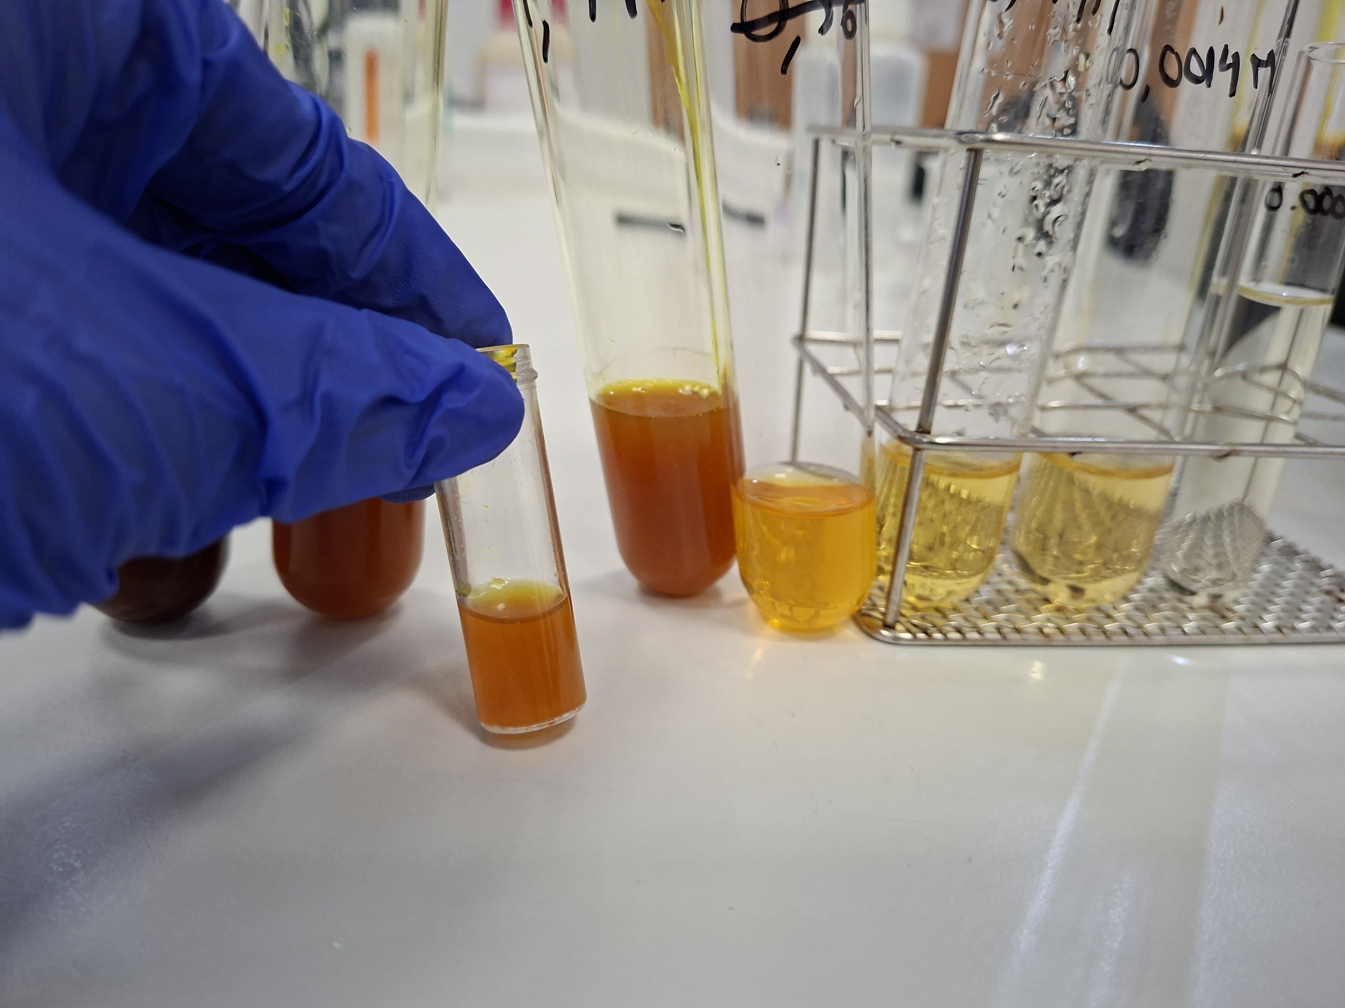
1
Colorimetry — Matching the Sample
Each group compares the colour of their unknown exoplanet sample against the reference ladder they created, and identifies the closest match.
TEACHING TIP (ask about this, so that students reason themselves, only give it away after reasoning):
If a sample's colour falls between two reference tubes, have students pick the higher concentration. That guarantees a slight excess of KOH in the next step rather than a shortfall of FeCl₃ — you want to know the maximum amount of iron oxide that can be extracted from the sample.
Sample
TAI Erasmus+ Project · Chemistry Lab Teacher Guide
8

Slide 9
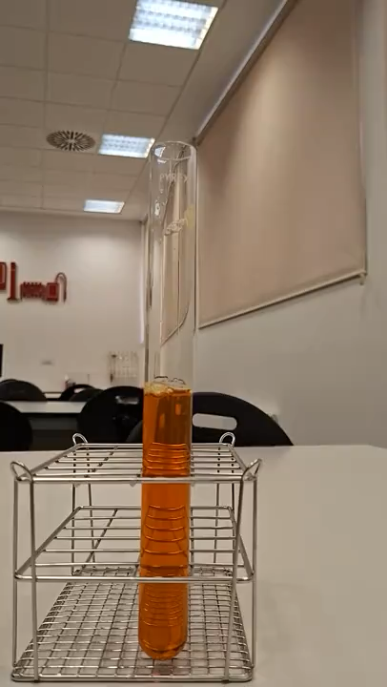
2
The Precipitation Reaction
Video
FeCl₃ + 3 KOH → Fe(OH)₃↓ + 3 KCl
Once a group knows its sample's approximate concentration, they calculate exactly how much KOH is needed to react completely with 100 mL of sample, dissolve that KOH in water, and combine the two solutions.
WORKED EXAMPLE — 0.1 mol/L sample
100 mL × 0.1 mol/L = 0.01 mol FeCl₃ → needs 0.03 mol KOH
$$0,03 moles KOH⋅56,11\frac{g}{mol}=1,68g KOH$$
TAI Erasmus+ Project · Chemistry Lab Teacher Guide
9

Slide 10
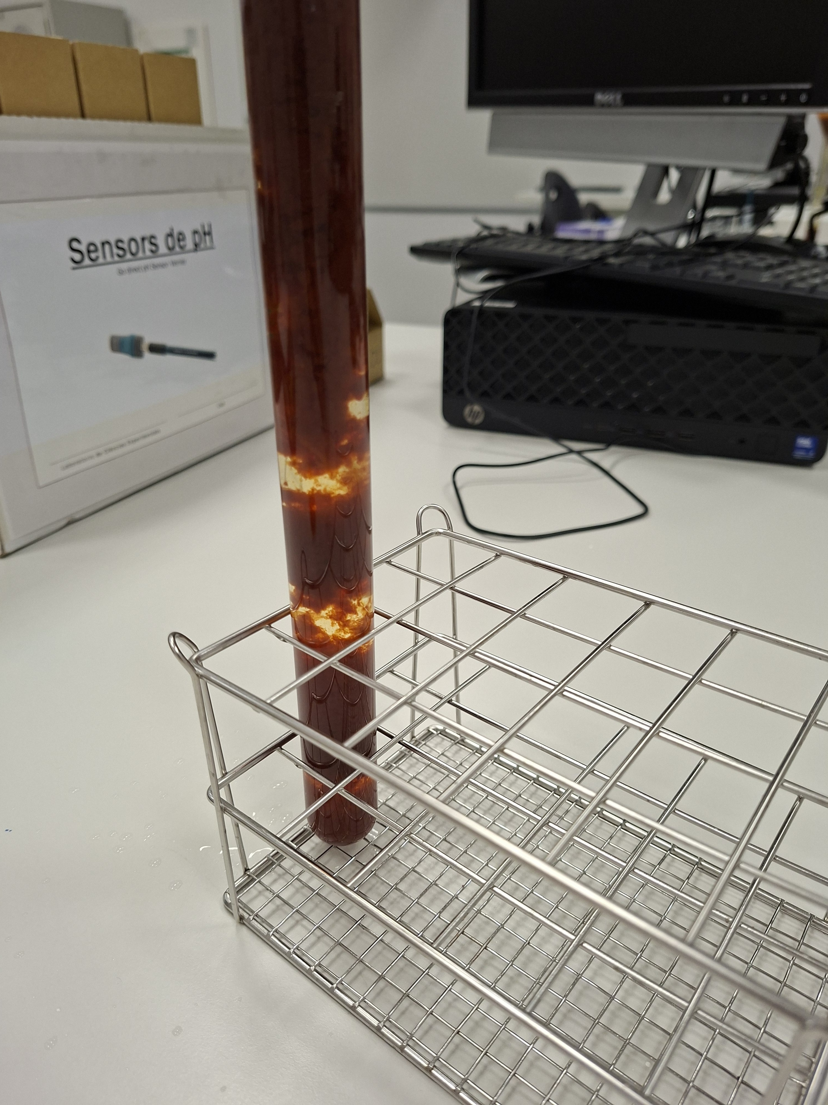
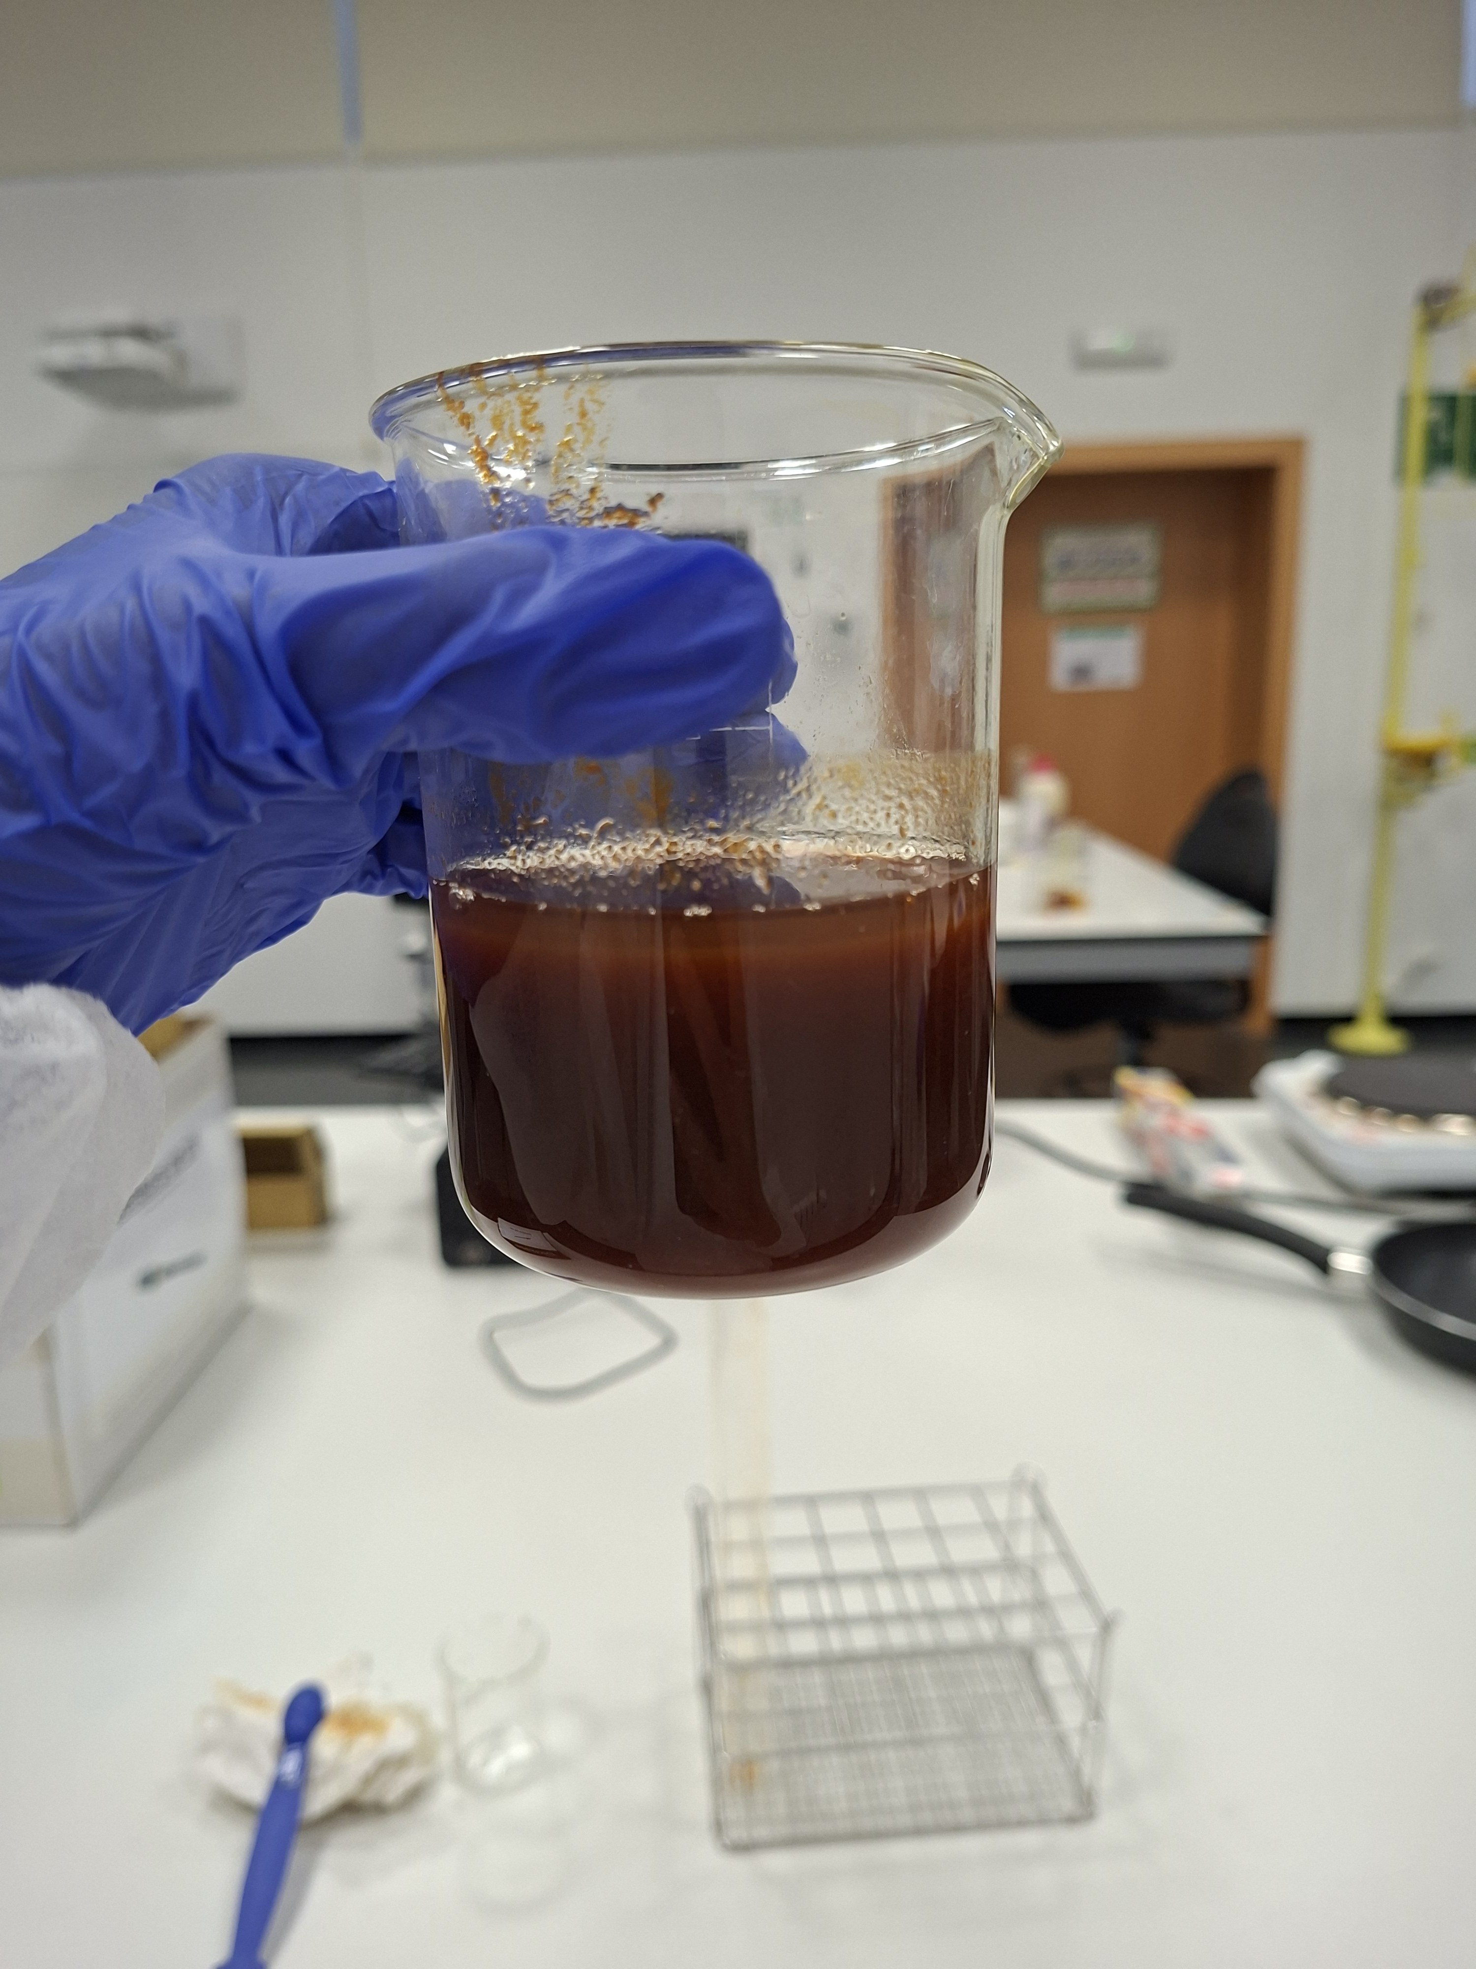
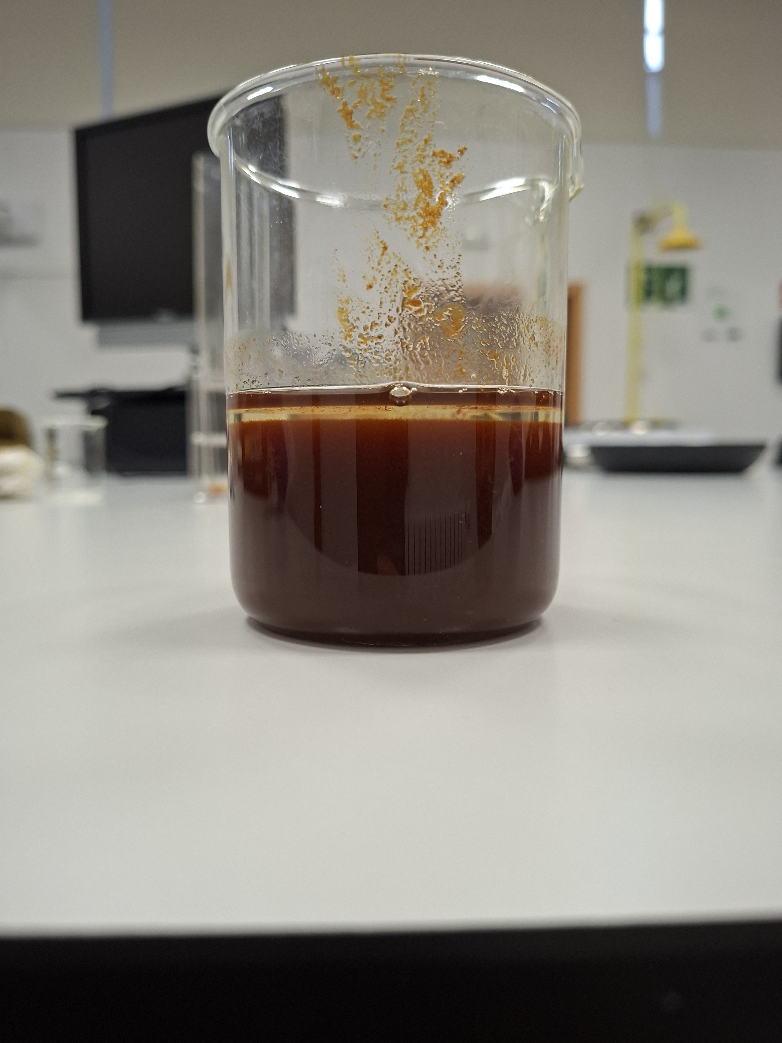
2
Watching the Precipitate Form
Step 2, continued
As the KOH solution is added, a reddish-brown precipitate of Fe(OH)₃ begins to appear almost immediately — a clear visual sign the reaction is working. Encourage students to record what they observe at each stage; it's useful evidence to compare against their final result later.
TAI Erasmus+ Project · Chemistry Lab Teacher Guide
10

Slide 11
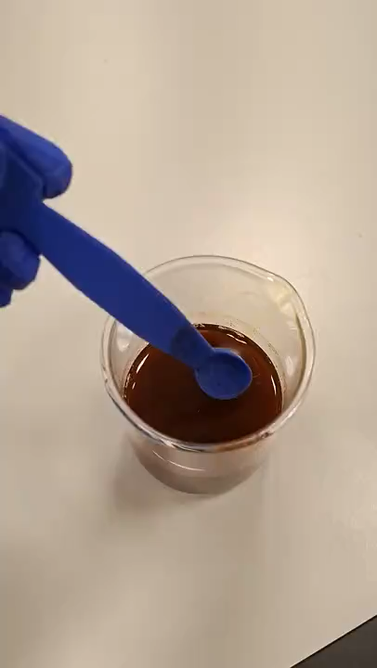
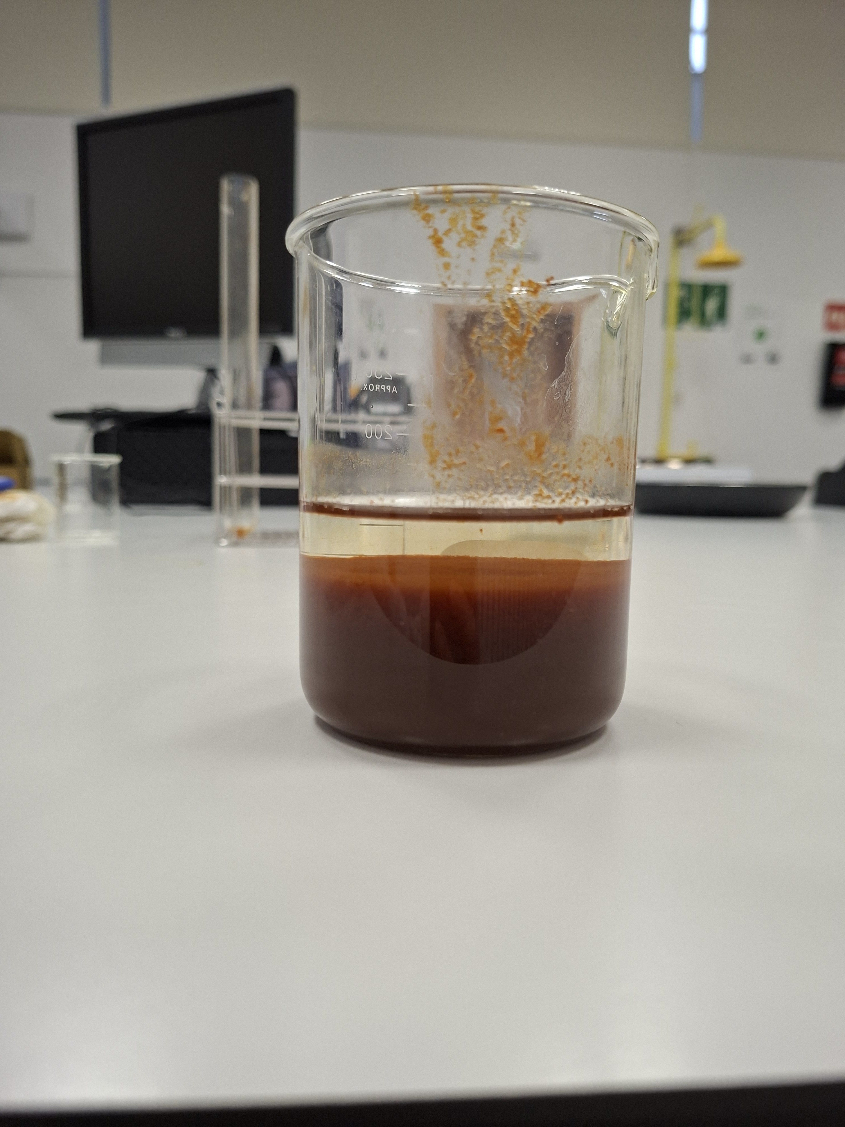
2
Reaction Complete
Step 2, continued
Once mixing is complete, all of the Fe(OH)₃ has precipitated out of solution, leaving a cloudy reddish-brown suspension that's ready for filtering.
Video
TAI Erasmus+ Project · Chemistry Lab Teacher Guide
11

Slide 12
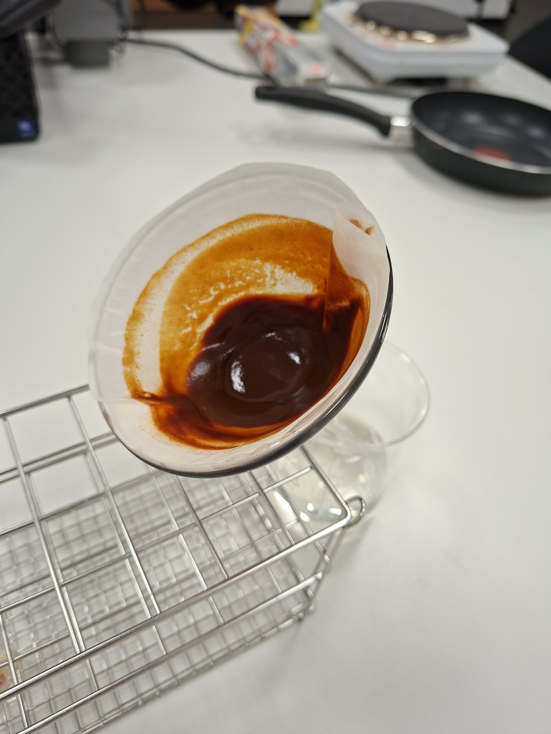
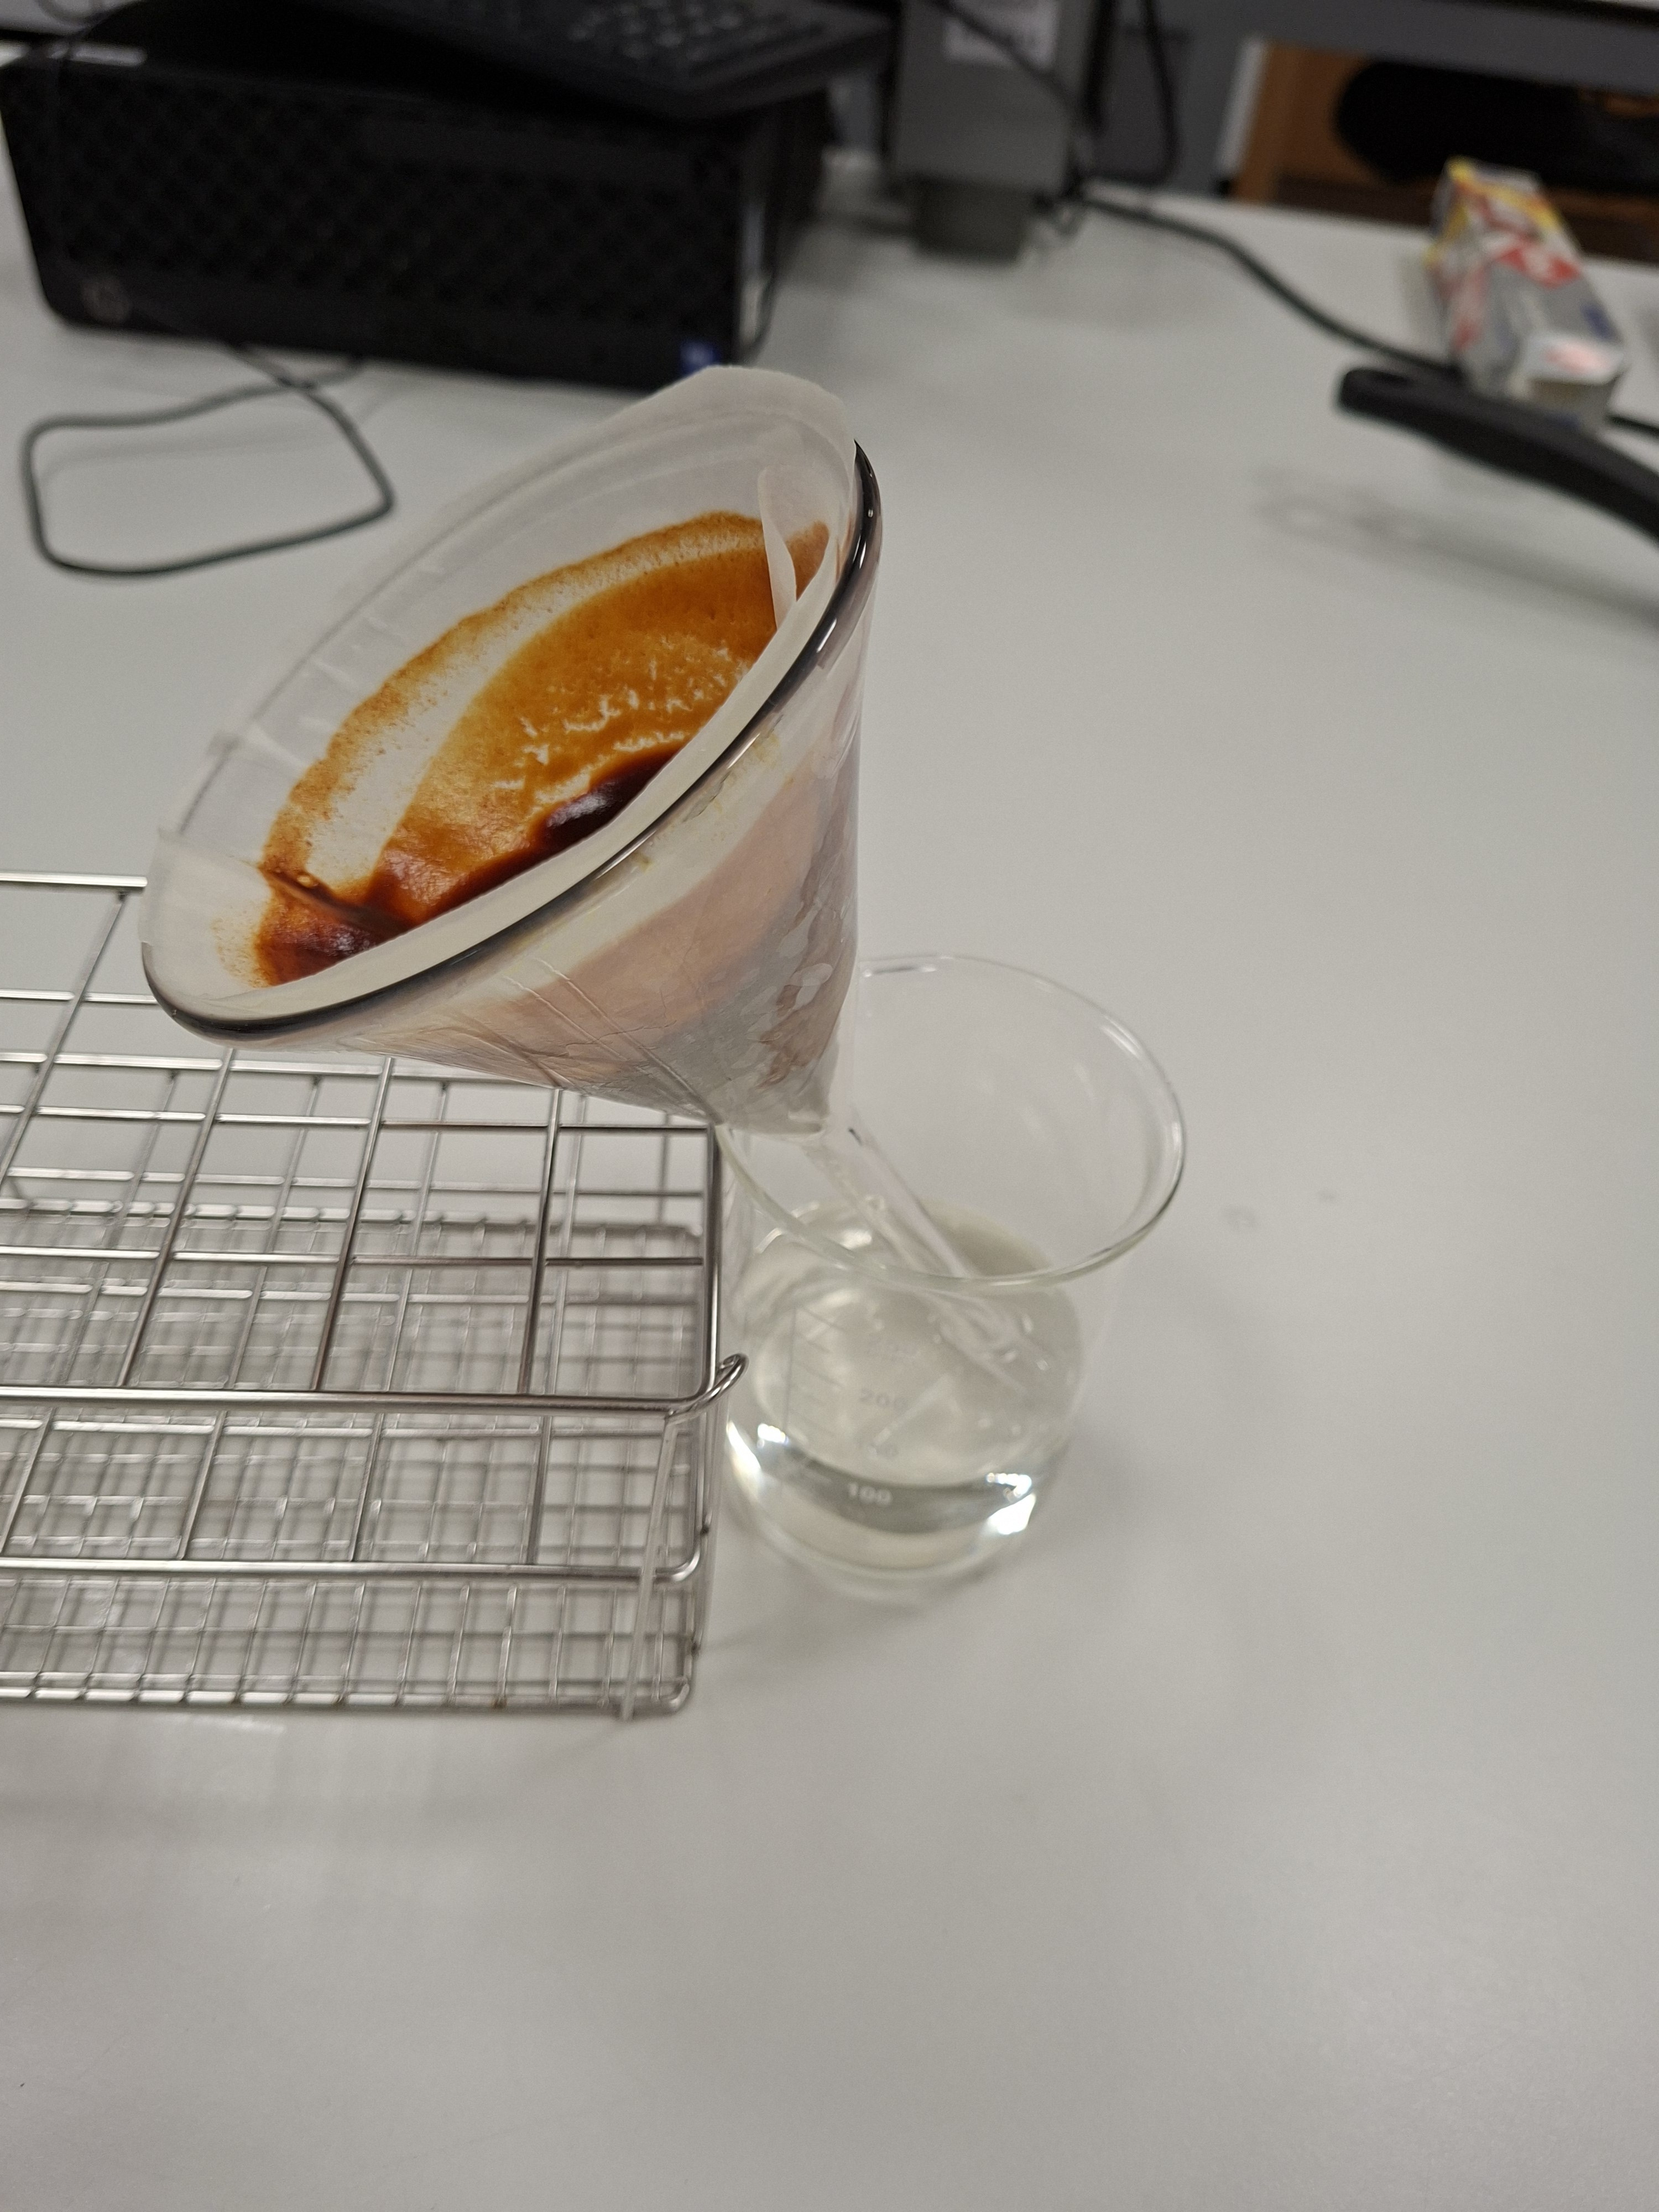
3
Filtering the Precipitate
Filter the mixture to separate the solid Fe(OH)₃ from the dissolved KCl left in solution. Only the solid collected on the filter paper moves on to the next step — the filtrate (liquid) can be discarded.
PRACTICAL TIPS
Let the precipitate drain fully before moving on to heating — a wetter sample takes longer to dry and can affect the final mass.
Having a bigger funnel will make the process faster. Otherwise, it takes a bit of time. The teacher can also prepare the filtered substances in advance, in case there is a time constraint. Another possibility is to leave the samples to dry on their own overnight and continue the lesson the next day.
TAI Erasmus+ Project · Chemistry Lab Teacher Guide
12

Slide 13
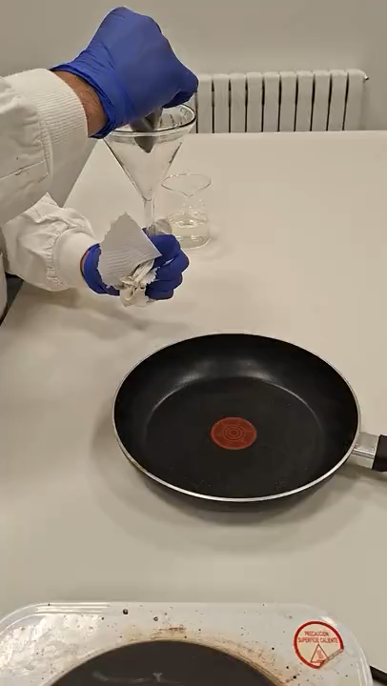
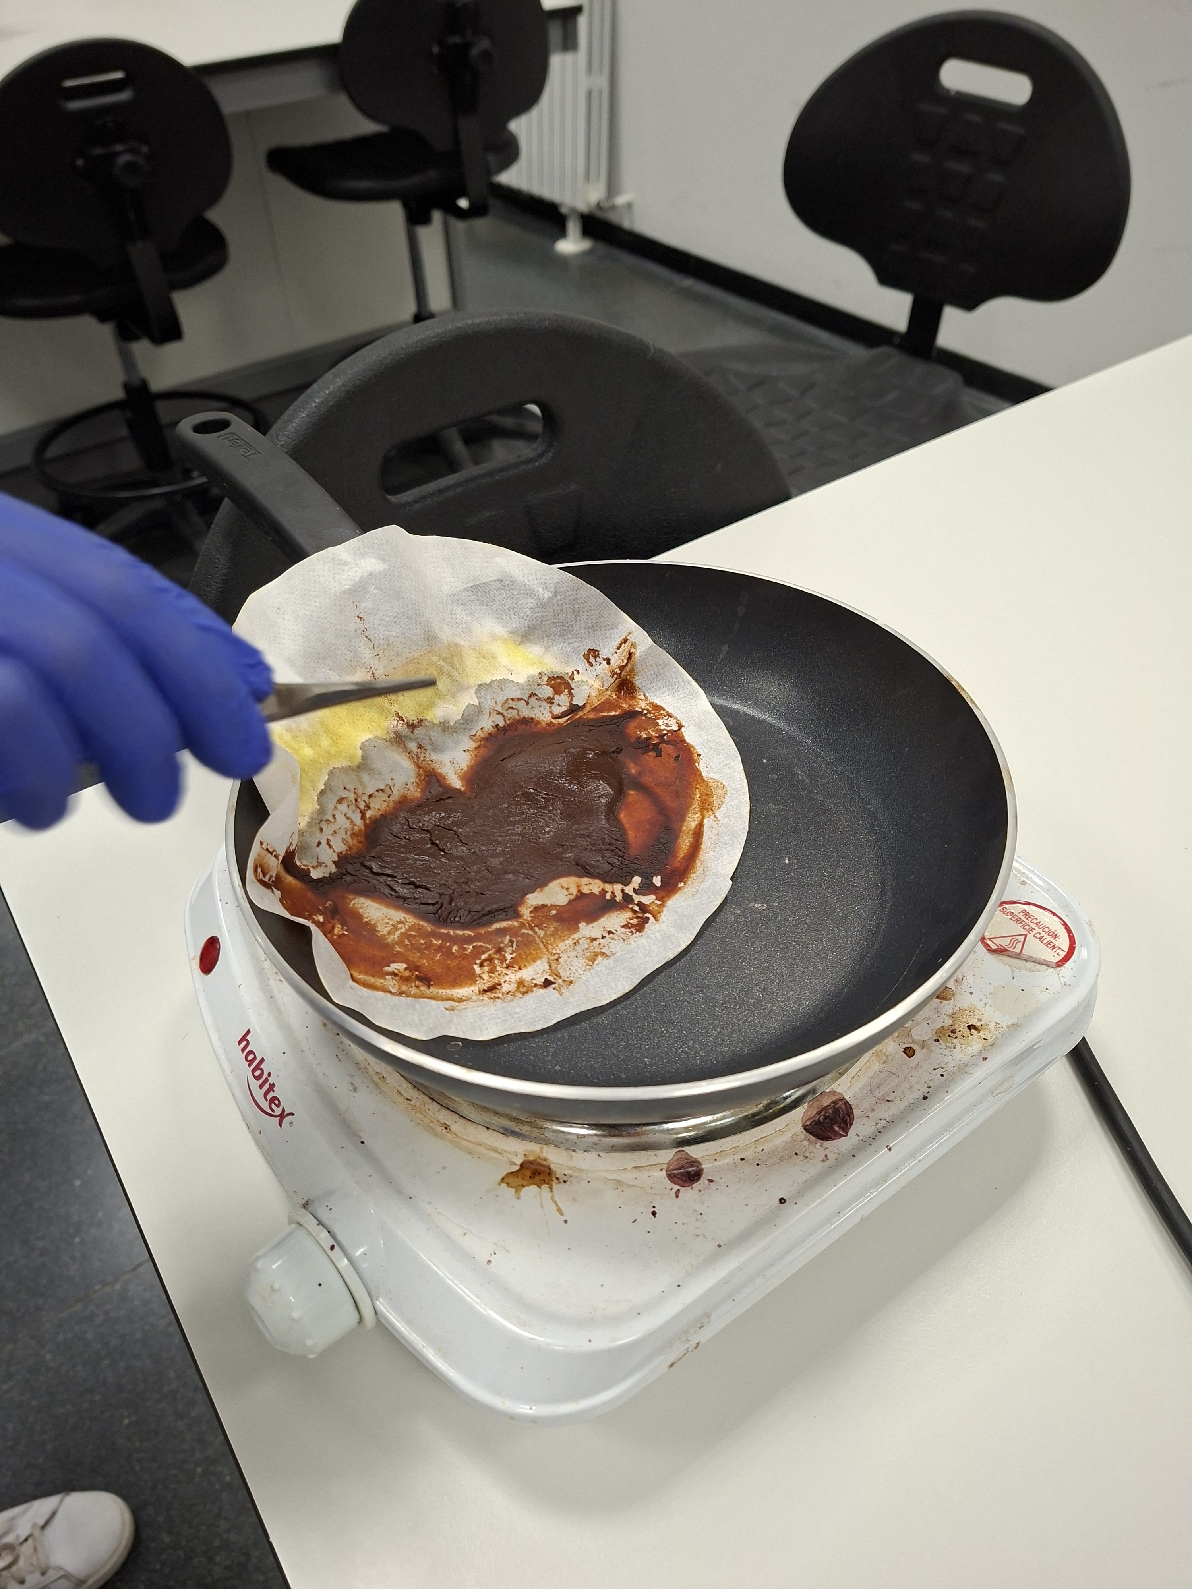
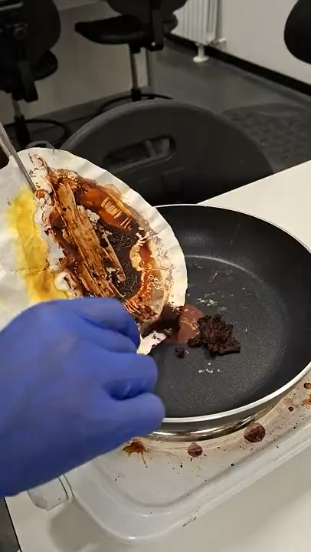
4
Roasting to Iron Oxide
2 Fe(OH)₃ → Fe₂O₃ + 3 H₂O
Heat the filtered, still-damp Fe(OH)₃ to at least 200°C (a hot plate or a pan that reaches this temperature works well). This drives off the water of hydration and converts the hydroxide into iron(III) oxide — the same reddish-brown pigment behind rust.
Video
Video
TAI Erasmus+ Project · Chemistry Lab Teacher Guide
13

Slide 14
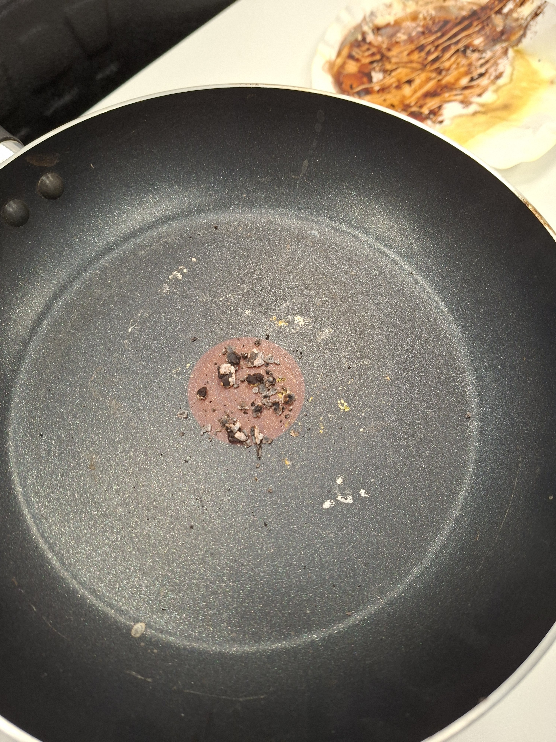
4
From Damp Solid to Dry Oxide
Step 4, continued
Keep heating and stirring occasionally until the sample is fully dry and stops changing appearance. This can take a while — plan for it in your lesson timing, or prepare it in stages between other tasks.
TAI Erasmus+ Project · Chemistry Lab Teacher Guide
14

Slide 15
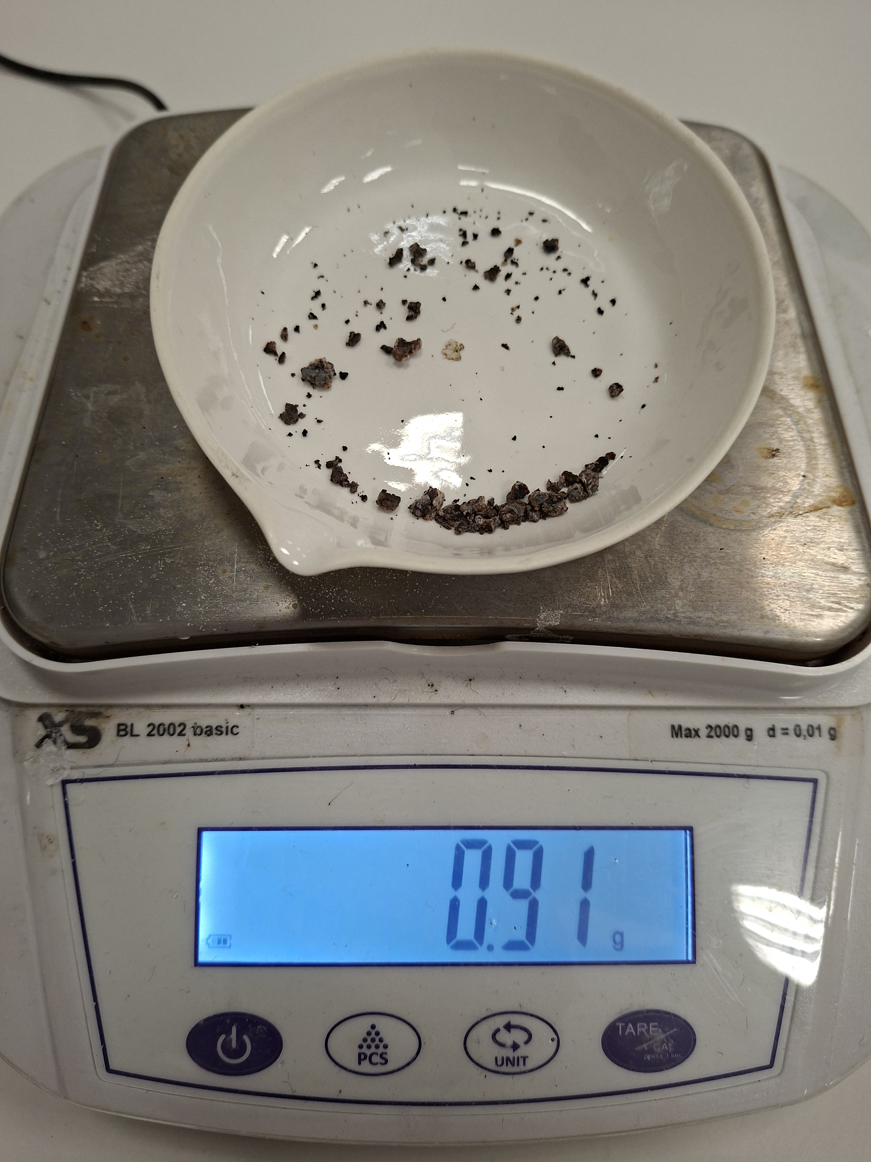
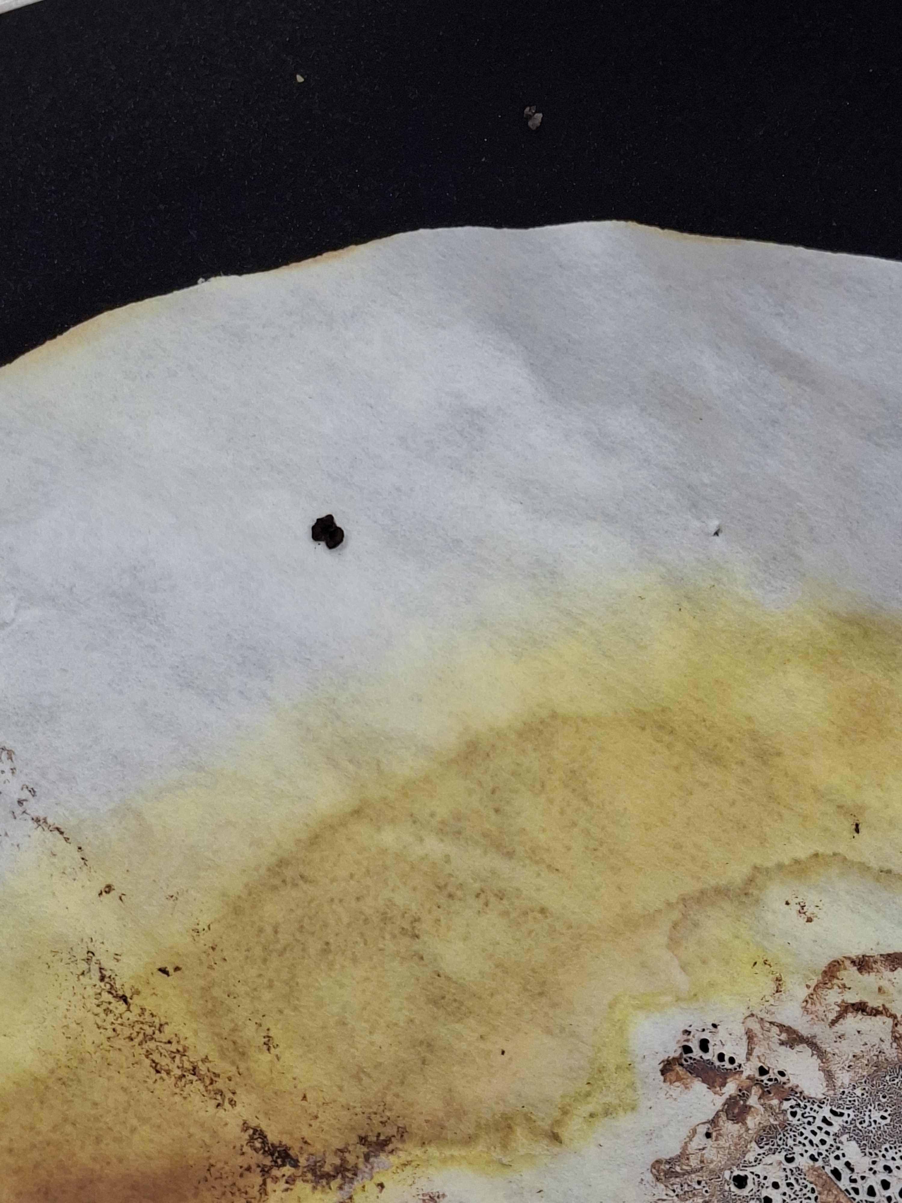
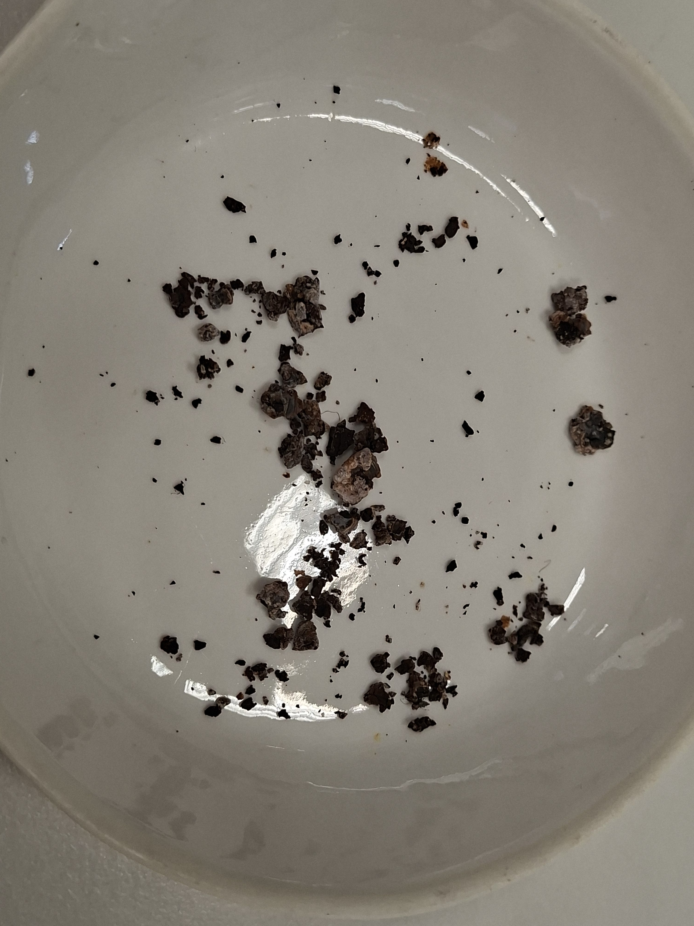
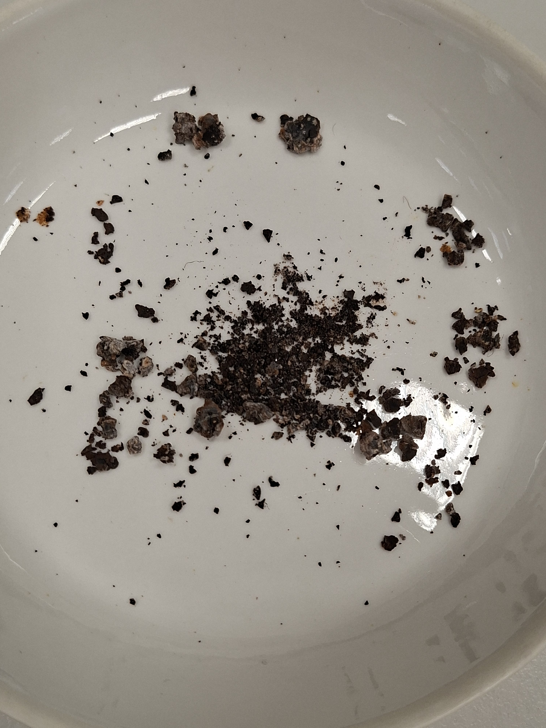
5
Weighing the Final Product
Once cooled, weigh the Fe₂O₃ and compare the measured mass to the theoretical yield calculated from the sample's known concentration.
WORKED EXAMPLE — 0.1 mol/L, 100 mL sample
0.01 mol FeCl₃ → 0.005 mol Fe₂O₃ → 0.005 × 159.69 g/mol ≈ 0.8 g Fe₂O₃ expected
If a group's result is noticeably higher than predicted, or their product shows pale/white specks instead of a uniform dark brown, this usually means leftover KOH or KCl was trapped in the sample — a good discussion point about filtration and washing technique.
TAI Erasmus+ Project · Chemistry Lab Teacher Guide
15

Slide 16
Choosing Sample Concentrations
Set a practical lower bound: with a balance that reads down to about 0.1 g, aim for at least 0.4 g of Fe₂O₃ product so every group gets a measurable, meaningful result.
That target works out to a lower concentration limit of about 0.05 mol/L for a 100 mL sample.
EXAMPLE SET — A CLASS OF 8 GROUPS
3 decoy samples (plain water + food colouring that is in the color range of the colorimetry, see slide 7)
0.1 mol/L → ≈ 0.8 g Fe₂O₃
0.2 mol/L → ≈ 1.6 g Fe₂O₃
0.8 mol/L → ≈ 6.4 g Fe₂O₃
1.6 mol/L → ≈ 12.8 g Fe₂O₃
3.2 mol/L → ≈ 25.6 g Fe₂O₃
Spreading concentrations this way means the final class comparison has real variation to discuss — some “exoplanets” are clearly better iron sources than others.
Groups with decoy samples will only know after doing the precipitating reaction, in which they won’t get the precipitate. This shows that even doing the colorimetry and having an hypothesis about what a substance is might not be enough. Only the reaction shows the true nature of the substance.
TAI Erasmus+ Project · Chemistry Lab Teacher Guide
16

Slide 17
Bringing It Together
Once every group has weighed their Fe₂O₃, gather the results on the board sorted by exoplanet, then open up the discussion:
Which exoplanets gave the most iron oxide — and why?
Could any decoy sample have fooled a group at the colorimetry stage?
If a group's yield doesn't match its predicted concentration, what does that suggest about errors in filtration, heating, or weighing?
Given everything we've learned, which exoplanet should the crew travel to next — and what's the evidence?
There's no single “correct” exoplanet built into the activity — the goal is for each group to defend its recommendation with data.

